Slide 1
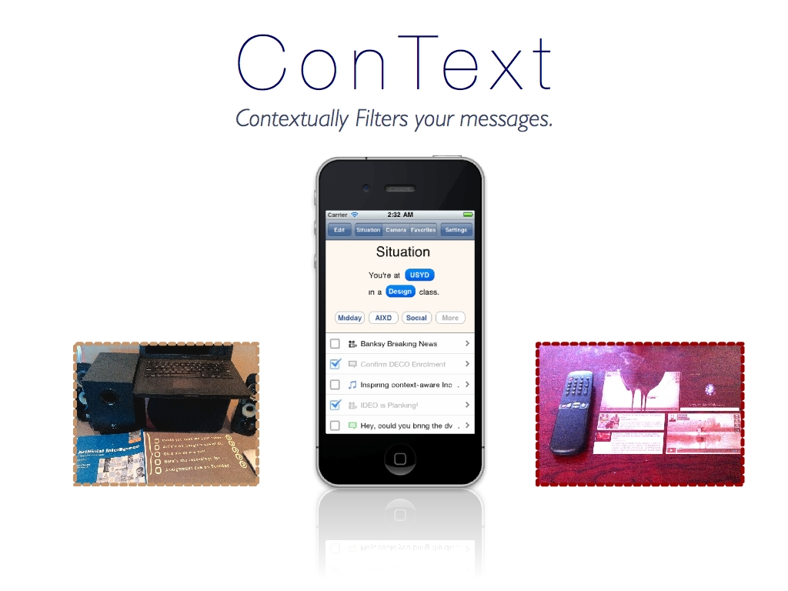
Notes:
Hi, so my final concept arose into an app called ConText which essentially filters your actionable messages based off your current or predetermined situations or surrounding objects. :)
But before I tell you more about my final app. I’ll take you through my process.

Slide 2
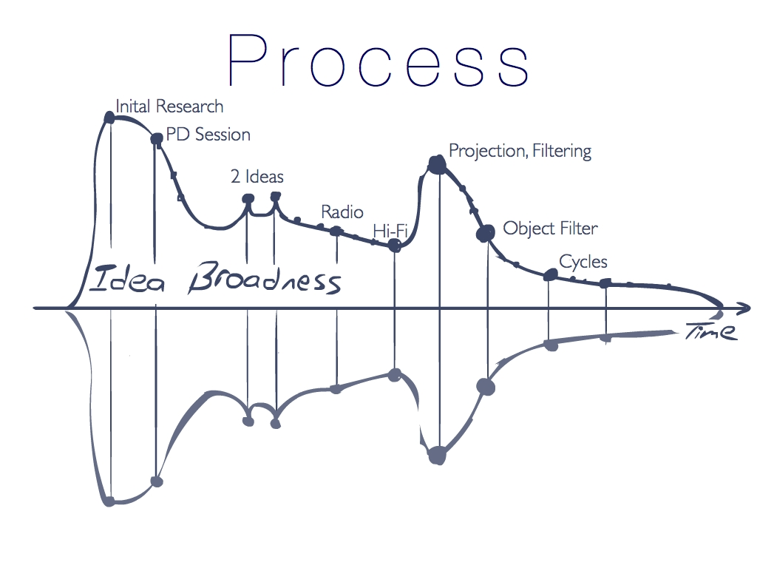
Notes:
I just want to mention, that even though they’re not always stated, general user inquiry and sessions were undertaken throughout to assess each iterated concept, with a mix of new and previous users.
Starting off this journey with initial research, I cast a relatively wide net, being quite overwhelmed by the possibilities the future held.

Slide 3
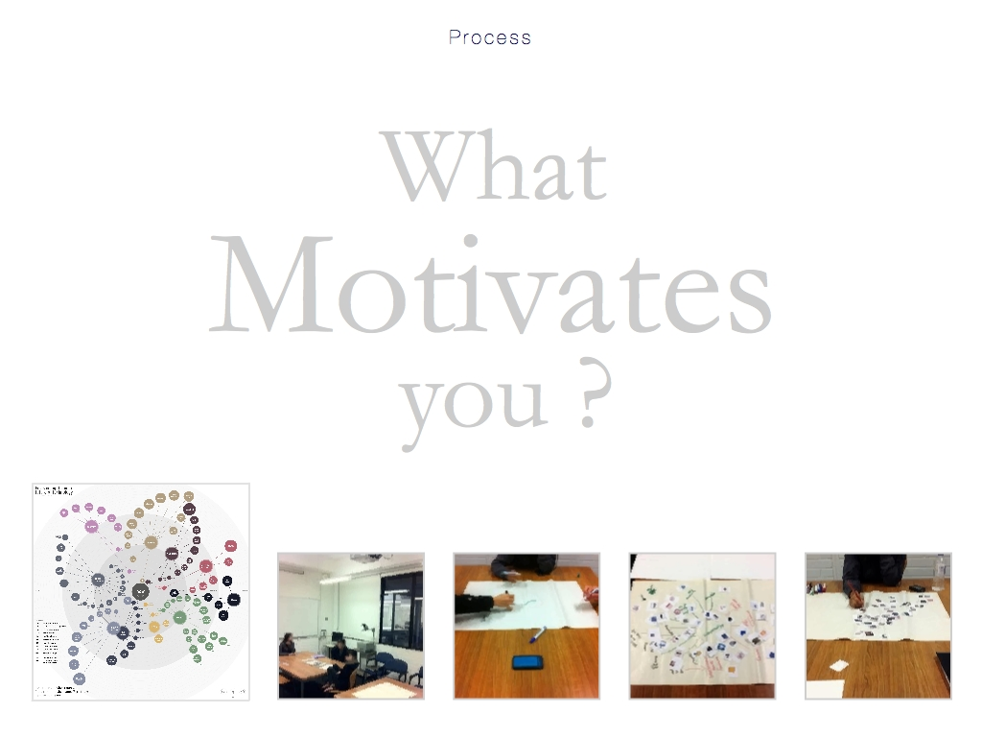
Notes:
This broadness lead to the identification of “Motivation” as a focal point for the app, and at how to facilitate it. This reflected itself in the PD session, which consisted of general observations like people’s wishes.

Slide 4
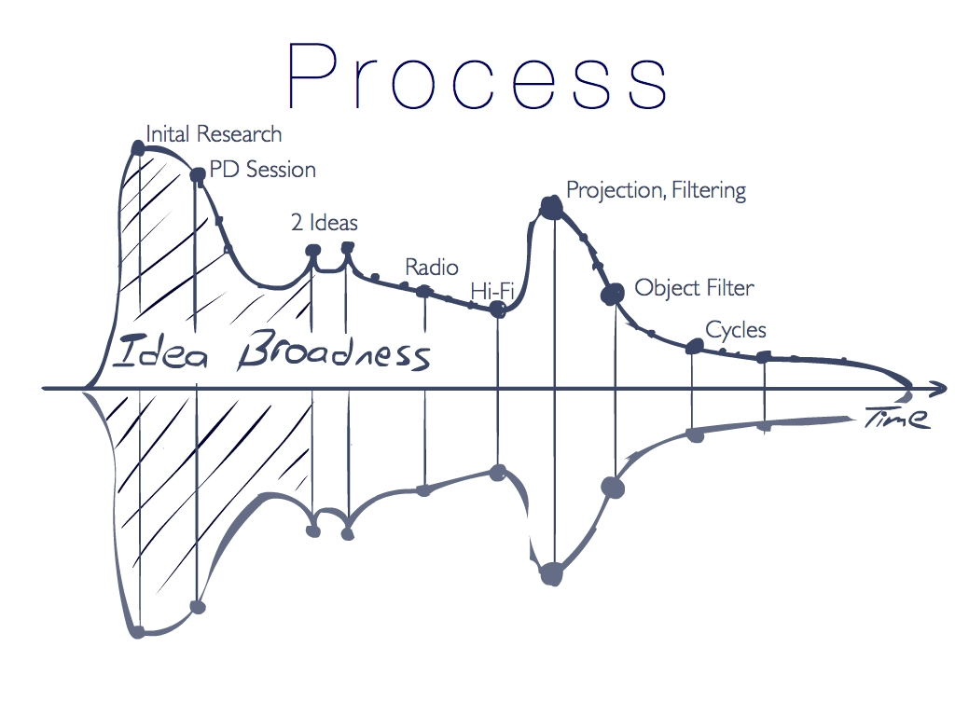
Notes:
( Though seemingly far from the final concept, some of the findings here still contributed to it, such as the effectiveness of tangible awareness, and perceptions of personal achievability.)

Slide 5
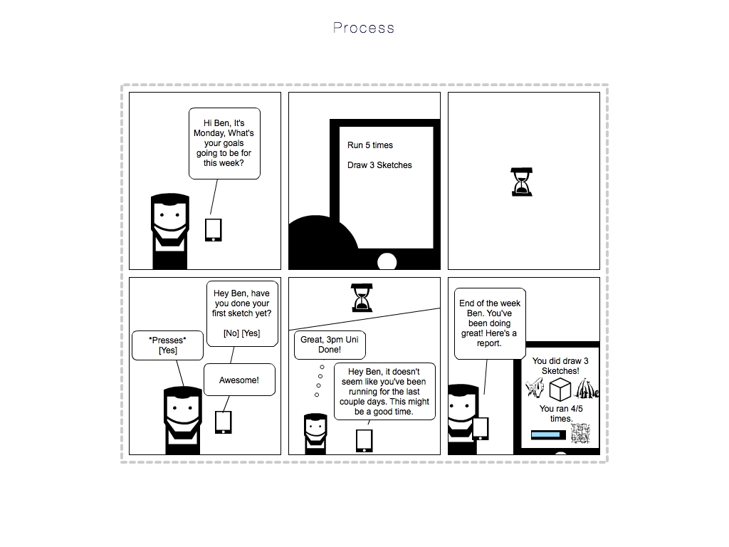
Notes:
This exploration resulted in two concepts.
A ‘Checker’ concept, which was essentially a combination of a virtual reminder and a diary.

Slide 6
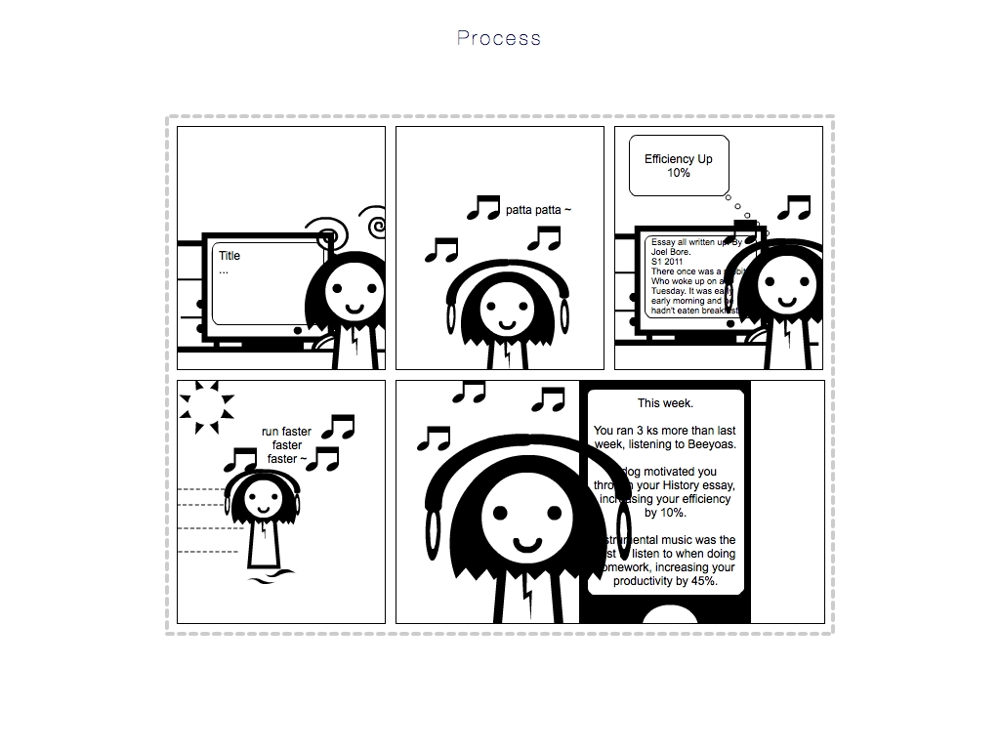
Notes:
Along with a smart music app that functionally and reflectively increased productivity.
Going with the former, I was advised against designing for Behavior Change. But instead to focus on brining awareness to users, of pre-existing data and their relationships.

Slide 7
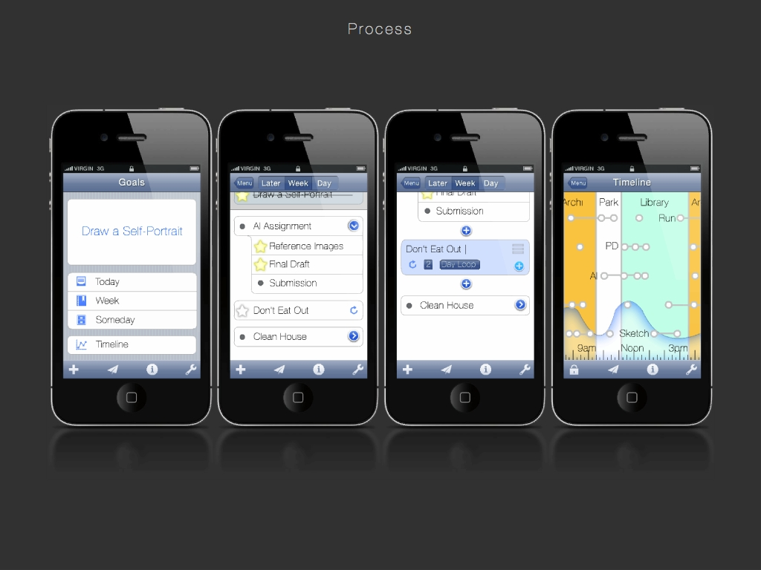
Notes:
The resulting concept was a context-aware task app. After having some fun researching related projects and philosophies (such as the GTD method), a minimalistic ideal was chosen which resulted in the concept you see here.
It was later, however discovered, that someone else (Alex Kan) had conceptualized a great similar idea of allowing people to reach their goals with game mechanics.
It was also pointed out that the idea was still too broad and that I should perhaps ignore input data (leaving it as an afterthought), but instead focus on what to do with the data, when the user already has it.

Slide 8
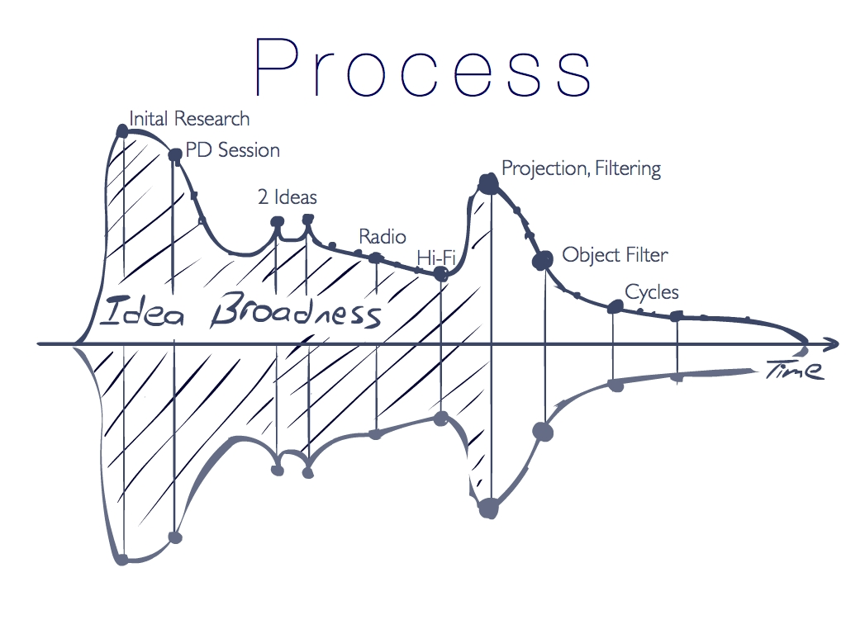
Notes:
This lead to a core, futuristic, problem, whereby we are increasing inundated with actionable messages (messages that require some form of response/task). The problem would be how we address these many items in our day-to-day lives.
I was also reminded of pic projectors as futuristic consumer hardware.

Slide 9
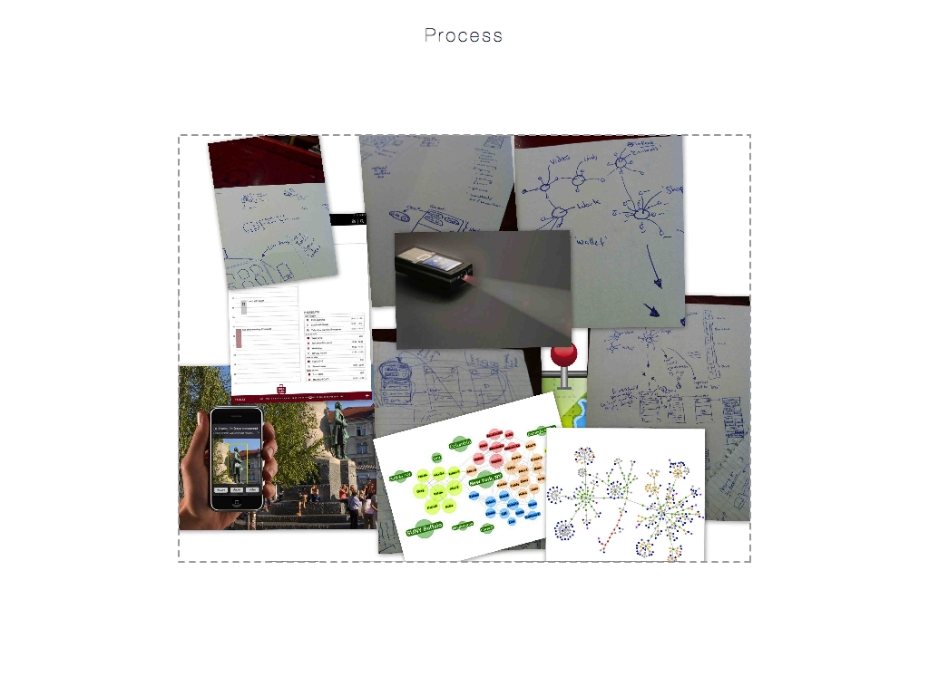
Notes:
This resulted in the concept of an app that “Filters your messages with your context” and considered multiple projection areas and multiple situations for such an app.
From user inquiries, this idea was then narrowed down to just utilizing objects as filters for projectable messages.

Slide 10
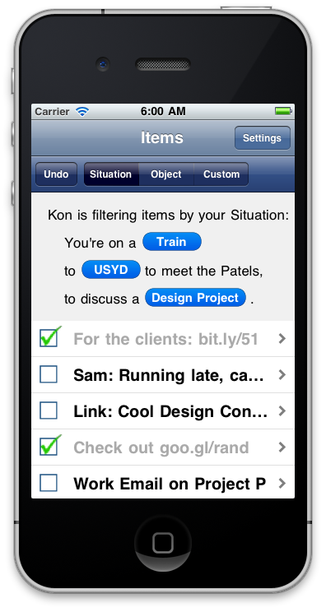
Notes:
Now a working hi-fidelity prototype of the concept could be developed. :D
Through a few iterative cycles of user testing (i.e. observations from just getting users to use the app, perform certain tasks, etc.), quite a few interaction changes were made (e.g. hiding complexities, brining the most used functions forward) along with ways of providing better aesthetics.
( It was also interesting to note that for this abbreviated view, users valued the type of media within the message slightly more than the originating channel (which was followed by the Topic of the message and lastly, who it was from). )

Slide 11
Notes:
This lead to the final app.

Slide 12
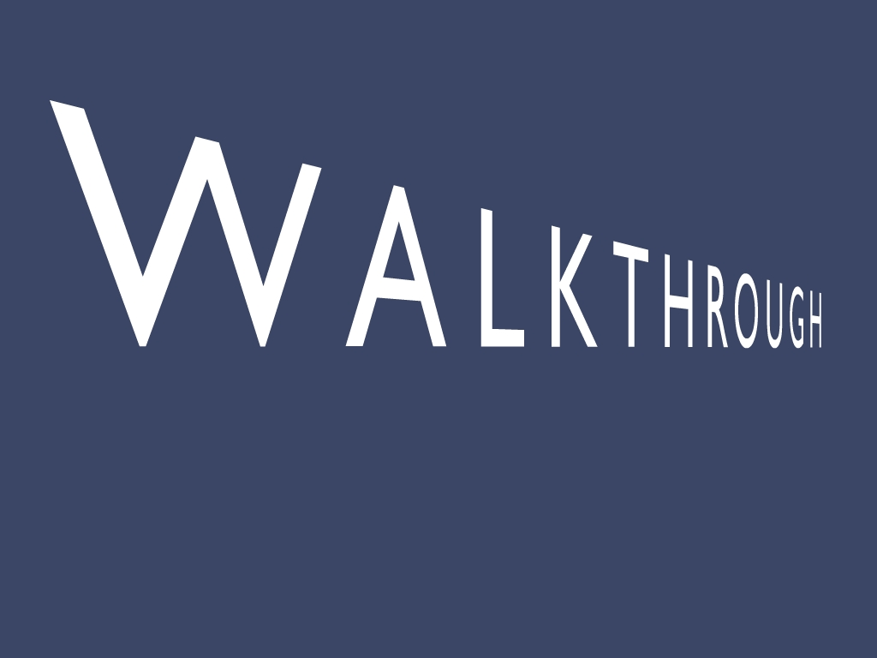

Slide 13
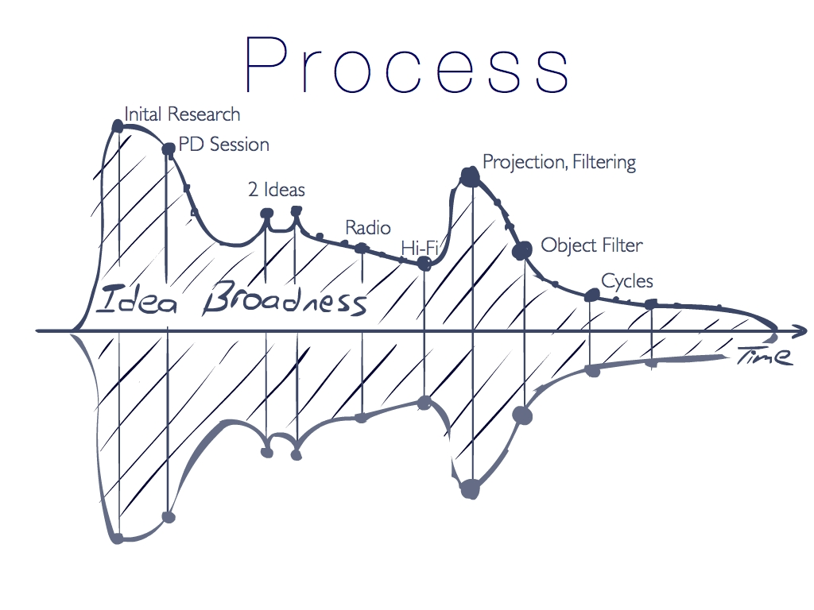

Slide 14
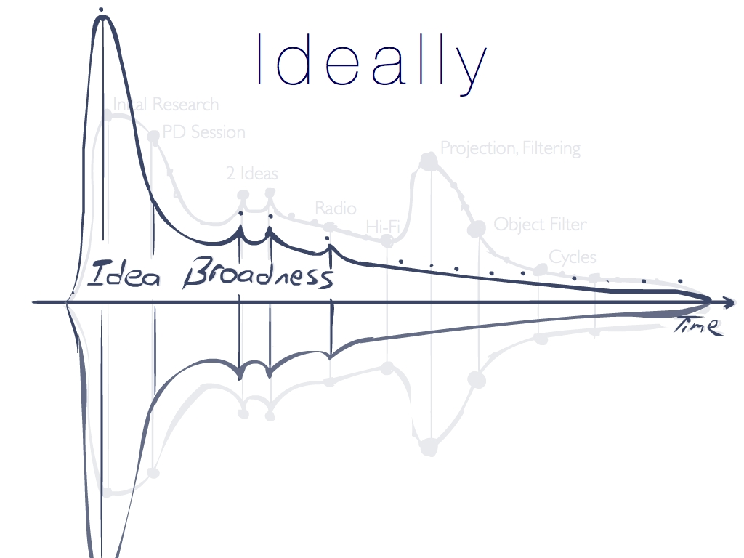
Notes:
I must say, Martin, Tamara and Melody gave lots of great directions, keeping me from straying too far.
In retrospect I believe I should of poured more effort into initial research, and identified a much narrower futuristic problem through academic research earlier on.
( Also at the start, I was my own worst enemy, constantly looking for ways to implement visualizations, even though, looking back, they weren’t always truly warranted. )
Most importantly though, I would have loved to use the amazing AttrakDiff measure of pragmatic and hedonic qualities much more, and more consistently throughout my design as the shear ability to assess the quality of an experience is very satisfying.

Slide 15
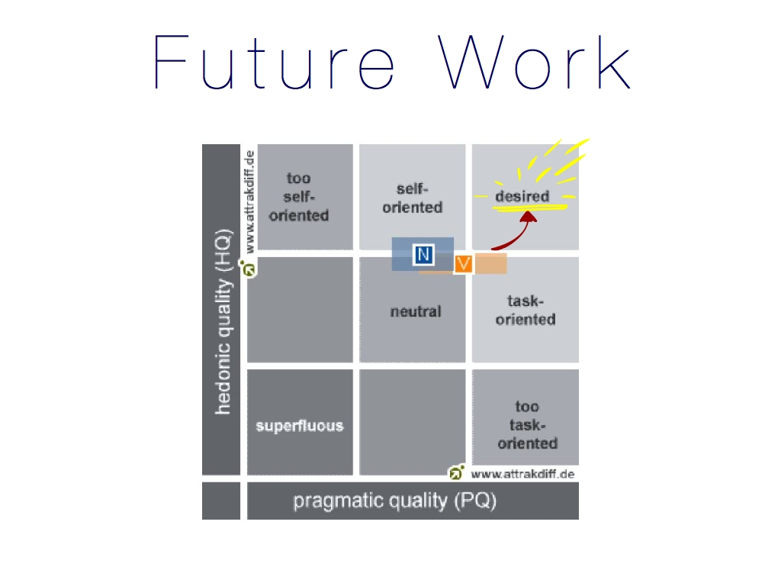
Notes:
In terms of future work, the app could still be improved along both hedonic and pragmatic axis.
A significant conceptual limitation to the current app is that it essentially is focused as a one-way response system to actionable messages, and is not flexibly considering for conversations or message construction.
Also unfortunate was that, machine learning algorithms, interactive detailed views of different types of messages and, acquiring data from personal channels (e.g. sms, fb api) were not implemented in this app.

Slide 16
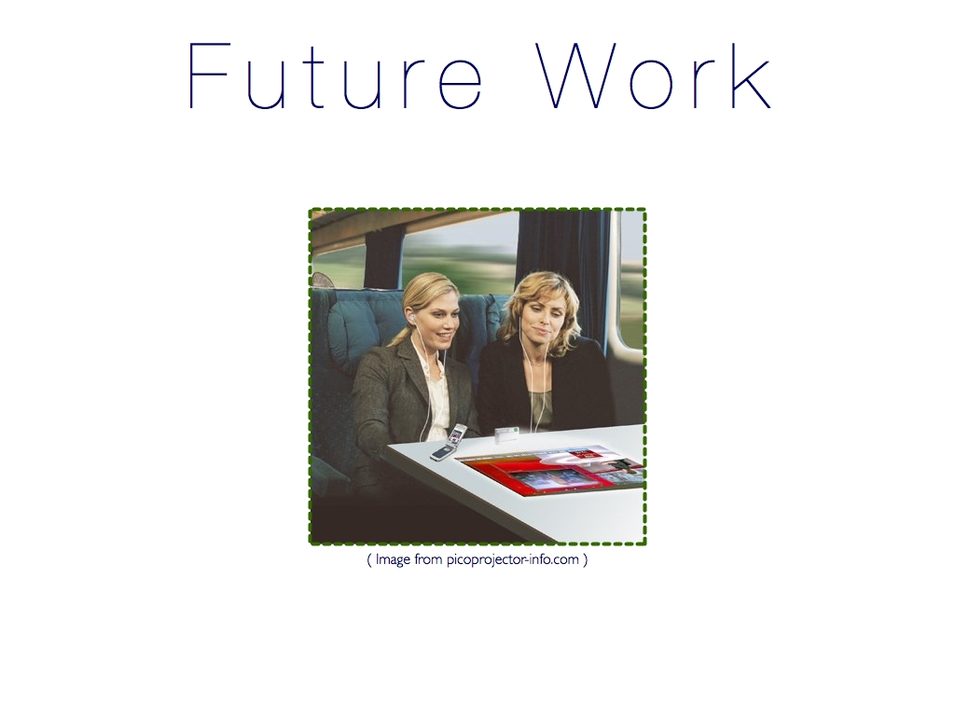
Notes:
The app would benefit more-so from a realistic implementation where users could use their own personal data and experience the Situational system (i.e. the algorithms intuitively) for themselves. I believe that allowing people to use their own data for long periods of time would go a long way for better evaluations and understanding.
This concept could also situate itself with other futuristic technological developments such as SPIMES and NUIs. Though even as it is, it could already be developed today. To quote William Gibson “The future is already here – it’s just not evenly distributed.” :)
And that’s it. Thanks for listening. :D

